Slide 1
Welcome to North!
…get your TILT on…

Slide 2
Who we are…
Toni Anderson, Business Faculty
Kathleen Chambers, Instructional Designer
Jamie Wilson, English faculty, Faculty Development Coordinator, Page One Writing Center Coordinator

Slide 3
Our introduction to the TILT framework…
The annual SBCTC Assessment, Teaching and Learning (ATL) conference two years ago
We’ve been sharing ever since
Kathleen, working with faculty in planning course structure and content
Jamie and I implemented this framework into our classrooms

Slide 4
Our Canvas Classroom
For today:
Attend the workshop on Monday, 2/24, 2:30 - 4:30, North Campus SLC Seminar Room (HS 1637A)
Bring two copies of a student-facing document with you to the workshop

Slide 5
Deepest gratitude to Jen Whetham of the SBCTC and Martin Cockcroft of Olympic College and the professional developers of the 5-star Consortium for their beautiful work and great tilt-ing of TILT!
Notes:
This slide deck is a hybrid of their slide decks-- Jen Add the links so people can see the originals too.

Slide 6
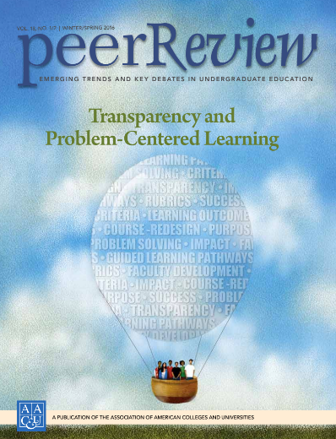
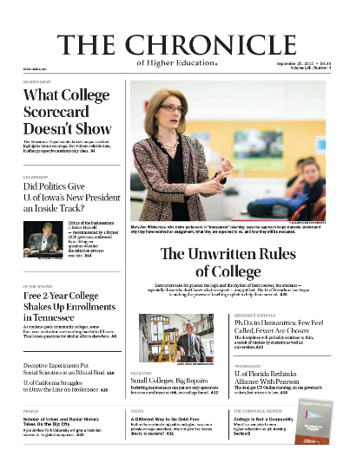
Mary-Ann Winkelmes, Ph.D.
Director, Instructional Development & Research, UNLV
Senior Fellow, Association of American Colleges & Universities
Nevada Humanities Board of Directors member Founder and Principal Investigator

Slide 7
Transparent Assignments: The Terminology
Nouns
Transparency In Learning and Teaching
TILT higher ed
Transparency framework
Transparent assignment template
Verbs
TILT, tilt-ing, tilt-ed

Slide 8
What Do We Mean by “Transparent”?
A way of making plain to students
Purpose: why THIS assignment (and not a different one); why the assignment matters in this course and life beyond the course; skills practiced; knowledge they should gain
Task: what steps they should take (and what mistakes they shouldn’t make) as they complete the assignment
Criteria for success: what success looks like on this assignment; how they will know if they’ve been successful
Notes:
Jen Give credit to Martin Cockroft for this beautiful slide AND for the exciting work faculty have done at Olympic.

Slide 9
Why TILT?

Slide 10
How does TILT contribute to closing equity gaps?
Let’s take a look at the data…

Slide 11
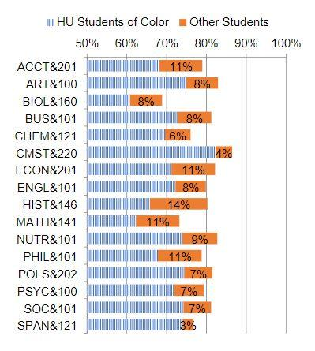
The Equity Gap
Statewide, historically underrepresented students of color have lower course completion rates (3%-14%) compared with their white and asian peers.

Slide 12
What about equity gaps at NSC?

Slide 13
Math 141

Slide 14
English 101

Slide 15
TILT Higher Ed’s Research Question
If teachers were to change one thing about their classroom practice that would benefit historically underserved students of color, what would be the one thing that would be of most benefit?

Slide 16
The Answer is Assignments
Scaffold students’ learning and success by making assignments more transparent.

Slide 17
What Do Students Need Most to Succeed?
The transparency framework is a classroom-based intervention that addresses the 3 most important predictors of success:
Academic confidence: I can learn math.
Sense of belonging: I’m supposed to be here. College is hard-- for everyone. My culture and values are reflected here.
Improved mastery of skills that employers value: What I’m learning will help me reach my long-term goals.
Notes:
Research shows these are the three most important predictors of student success: academic confidence, sense of belonging, sense of gaining employer-valued skills.
Credit to Martin Cockroft for this great explanation of the three terms

Slide 19
}
Small sample sizes
(Sources: TILT Survey; UNLV Data Warehouse/Office of Decision Support, 10/23/2017)

Slide 21
Transparent Assignments: The Results
Transparent Assignments boosted students’
Larger effect for traditionally underserved students.
Academic Confidence
Sense of Belonging
Persistence rates, short-term & long-term completions
Winkelmes. Liberal Education 99, 2 (Spring 2013) Winkelmes et al. Peer Review 18, 1/2 (Winter/Spring 2016)
Notes:
*Confidence and belonging are predictors of increased persistence and higher grades.
**Skills such as writing, collaborating, applying concepts to new situations, evaluating reliability of information, learning independently
Note: The effect was larger for traditionally underserved students
Winkelmes. Liberal Education 99, 2 (Spring 2013) Winkelmes et al. Peer Review 18, 1/2 (Winter/Spring 2016)

Slide 22
Students Respond to TILTed Assignments
“It would increase my overall confidence in the class.”
“I’d have a better understanding of the Relevance of the lessons and class in general in relation To my education and career.”
“I would feel that the instructor wants to set me up for success.”
Spokane CC Student Voices on Transparency -- Angela Rasmussen, Sally Heilstedt, TILT 211 Summer Institute, August 2018
Notes:
At the TILT Summer Institute in 2018, Angela Rasmussen (Spokane CC) and Sally Heilstedt (LWTech) shared results of their student voices project on TILT. Students in a focus group were shown before and after examples of TILTed assignments and asked for their feedback. This is what they said about the after (TILTed) assignments.

Slide 23
TILT Researchers Found ...
Quantitative data showed that the retention rates of the students in the original TILT study increased 13% to 15%-- not just 1 year later, but 2 YEARS LATER.
Notes:
Just receiving transparent instruction in 1 course.
2 TILT-ed assignments
Hence, 2,1,1 TILT
2 assignments, 1 course, 1 quarter

Slide 24
Transparent Assignments: The Takeaway
Transparent assignments (TILT) are an equity strategy.
Notes:
Denise

Slide 25
2 Assignments, 1 Course, 1 Quarter
Just 2 tilt-ed assignments in 1 course makes a difference for students
Notes:
Yilin

Slide 26
A pause: What thoughts or questions do you have?

Slide 27
EXAMPLE: Less-Transparent Assignment
Read the less-transparent assignment and discuss with a partner:
Purpose
Why THIS assignment (and not a different one)?
Why does this assignment matter in this course and life beyond the course?
What skills will be practiced; what knowledge should they gain?
Task:
What steps should they take (and what mistakes should they avoid) as they complete the assignment?
Criteria for Success:
What does success look like on this assignment?
How will they know if they’ve been successful?

Slide 28
Discuss the More-Transparent Assignment
Now compare the less and more-transparent assignments, and discuss with a partner. Are the following elements more clear?
Purpose
Why THIS assignment (and not a different one)?
Why does this assignment matter in this course and life beyond the course?
What skills will be practiced; what knowledge should they gain?
Task:
What steps should they take (and what mistakes should they avoid) as they complete the assignment?
Criteria for Success:
What does success look like on this assignment?
How will they know if they’ve been successful?

Slide 29
Discussion of a Student Facing Document
Read the Seattle Promise Announcement and think about it in terms of the Transparent framework:
Purpose
Tasks
Criteria for Success
Notes:
Congratulations! You’ve we see your commitment!
You’ve navigate obstacles and hurdles …
made it successfully to fall quarter! Here’s what you need to do now to ensure that your students loans are still covered so you’re not paying student loans the rest of your life. Here’s the things you need to do to keep your scholarship.

Slide 30
Elbow Partner Discussion: Purpose
Why THIS message (rather than nothing or some other message)?
Why is it important for its audience to read? What prior knowledge/skills do they need (or need to be reminded of) to understand the message?
What knowledge should this audience take with them from this message?
Notes:
What would you get out of meeting with your retention specialist? WHY and HOW
Why you SHOULD register as soon as you can
Classes fill up … get teh schedule you
Best opportunity to get a scheule you’ll be happy if if you register early
Define SAP …
Milestones they MONEY IS TIED TO THIS!
No one likes unpleasant surprises …
We want to make sure your tuition is still paid for …
Make sure you keep your tuition waiver so you’re not paying student loans for the rest of your life
Knowledge: Student-centered reminder of what your retention specialist is and can do for you
Mindsets around asking for help and when and why you reach out to teachers or staff
Skills: Get familiar with asking for help; self-monitoring-- self tracking. Track and manage their to-do list
Meeting their future goals in their life and their careers
Free tuition
Wrap around support
They will lose their scholarship
Maintain eligibility
Direction on how to do the check-in
Keeps the steps in one nice place for them to find
Reminder these things need to happen because we all forget
Place to come back to it “I lost the e-mail!” Saved in their account so they can come back to it as needed
What Starfish is
How to log in to Starfish
When you see an underlined blue link, they should click on it
Planning ahead and thinking of their future (the end in mind)
What a retention specialist is, what that means … Consequences. If this doesn’t happen, this is what will happen to me. Affects their family too.
They have to do these things. Requirement. Or else this happens.
Their retnetion specialist is there to answer questions. They have a designated person to contact.
You have jumped through many many hoops. Continuations of things they done previously-- different messages or texts. Not a new student any longer. Should have met with their retention specialist … summer check in.
Very quickly be in trouble if they miss one thing.
Deadlines are months away.

Slide 31
Elbow Partner Discussion: Task
What is this student supposed to do in response to this message?
Notes:
Make an appointment with a retention specialist
Retention specialist-- provide academic advising, campus navigation … main point of contact. Checking off that a student has done this.
Primary advisor.
Coach. Success coach.
This is your go-to person for everything. They’ve got your back. They will be your advocate. They’ll help make sure you do what you need to do, get the classes you need to take …
Register for classes
Pass your classes

Slide 32
Elbow Partner Discussion: Criteria for Success
What does success look like for this message? For the student? For the sender?
How will a student know they’ve responded or acted in a relevant, timely way?
Notes:
Personalized
Makes an appointment and meets with their retention specialist
Make it through starfish on their own
If you use your stargish login, there is a check mark! A tool that checks this off. Your retention specialist will follow up with you …[
No news is good news ...

Slide 33
Why charrette?
Notes:
Kathleen ...an intense period of design or planning an activity. We’re replicating how long a student might take when reading assignment instructions and INVENTION. This protocol asks you to shift your mindset away from the words on the page and generate a new approach to your communication that takes your reader in mind. You will walk away with actual words, phrases, and ideas to “TILT” the document you brought today.
Task: Engage in 3 rounds of facilitated dialogue (purpose, task, success) as you practice speaking and listening.
Criteria for Success: You will see your document with new eyes! Revision is “RE Vision.” In addition, you’ll start to internalize the criteria to help you further “TILT” other documents.

Slide 34
Purpose
When we understand that systemic and institutional barriers are not inclusive of our student populations, we can take action to remove those barriers.
In the practice of tilting assignments we have the opportunity to clarify, and equalize, the successful understanding, and completion, of our assignments and documents for all students.
Embracing this process not once but as an ongoing process we have the opportunity to reflect and challenge our own assumptions and biases allowing more empathy and connection with our students and our community.
Notes:
Kathleen

Slide 35
Step 1
Choose an assignment/document to TILT
Notes:
Kathleen

Slide 36
Step 2
Sit with a disciplinary or department stranger
Notes:
Kathleen Unrelated to your class, field: Perspective of someone without your training or expertise to point out the language, expectations you are taking for granted.
Good Professional development 2. Transparent and reflective practice 3. Powerful learning in collaboration 4. Get us out of department silos 5. Different skills and focus when reading your document 6. Tilt more than once for this reason

Slide 37
Roles
As a novice student…
Respond to the prompts for each phase as a novice student.
As the author…
Listen and observe. Do not coach or explain.
Notes:
Kathleen: Student: purpose, task and criteria. You may talk through the prompts and/or make notes on your partners’ assignment.

Slide 38
Transparent Assignments: The Template
Purpose
Skills practiced
Knowledge gained
Task
What to do
How to do it
Criteria
Checklist or rubric in advance so students can self-evaluate.
What excellence looks like (multiple annotated examples)
Relevance to students 5 years out
Connection to Learning Outcomes
Notes:
What do we mean by Transparency? What does a Transparent Assignment look like? It clarifies for students three things: the Purpose of the assignment, the Tasks (in order) for completing the assignment, and the Criteria for successful work.

Slide 39
Purpose: Author Speaks, Student Listens
As the “author” you have 2 minutes each to explain the purpose of the document/assignment to your partner who is playing the role of a “student.”
Notes:
Kathleen
Why THIS assignment (and not a different one); why the assignment matters in this course and life beyond the course; skills practiced; knowledge they should gain

Slide 40
Purpose: Student Speaks, Author Listens
The “student” has 2 minutes each to offer feedback.
“Author” is to remain silent and take notes. The “student” will provide you language you can use to TILT your assignment/document.
Notes:
Kathleen

Slide 41
Purpose: Student Talking Points: “Say Back”
Why this message or assignment is important?
What prior knowledge/skills do you need (or need to be reminded of) to understand the message or assignment?
What knowledge should you take away from this message or assignment?
Notes:
Kathleen

Slide 42
TASKS
What are the steps in completing the assignment or document and
What you are supposed to DO as a result of receiving the document or communication?

Slide 43
Task: Student Speaks, Author Listens
The “student” has 3 minutes to tell the “author”
What steps would you take in completing the assignment or responding to the document, and in what order?
Where did you get stuck or anticipate getting stuck?
“Author”: remain silent, observe and take notes. Listen for mistakes or missed steps. Do not coach or explain.
Notes:
Kathleen
Task: What steps they should take (and what mistakes they shouldn’t make) as they complete the assignment. Take notes. Explain exact steps: Give an example

Slide 44
Tasks: “Author” Speaks, Student Listens
Author has two minutes to respond.
Is this student on the right path to success?
Did the student list any steps that would lead them off the path to success?
Did the student get all the steps?
In the right order?
Did anything the student say surprise you?
Notes:
Kathleen
Task: What steps they should take (and what mistakes they shouldn’t make) as they complete the assignment

Slide 45
Criteria for Success: Student Responds, Author Listens
Take 3 minutes each to offer feedback on the criteria for the assignment
As the recipient of this message or assignment, what would success look like to you?
How confident are you that you can complete the task(s) successfully?
What else would you need in order to be confident you are doing excellent work?
Author: remain silent, listen and take notes.
Notes:
Kathleen
Criteria for Success: What success looks like on this assignment; how they will know if they’ve been successful

Slide 46
Criteria for success: author speaks, student listens
Take 3 minutes to share your criteria for success:
What does success look like for this assignment or document? For the student? For you as the sender?
How will a student know they are successful or have responded or acted in a relevant, timely way?
Notes:
Kathleen: Criteria for Success: What success looks like on this assignment; how they will know if they’ve been successful

Slide 47
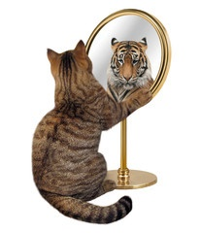
Reflections…
Take 1 minute to jot down notes of reminders – of the framework, or what you need to do next to complete your project
You will finish this project independently after the workshop has concluded
Make sure to view the rubric to ensure completion and stipend
Your artifact is due in Canvas by March 30

Slide 48
Thanks for attending today.
Stay TILTed!!
Toni Anderson
Kathleen Chambers
Jamie Wilson

